Slide 1


Welcome to the MN M365 Fall Admin Workshop Day 2021!
Please help us drive event awareness by tweeting and posting about your experience at the Workshop:
@o365MN #M365WorkshopDay
Thank you for your participation!

Slide 2







Thank You To Our Sponsors!

Slide 3
Live Event vs Webinar
Live Event
Webinar
Produced/thousands in audience
Portions may be live, portions may be prerecorded
Registration must be setup (MS Forms, etc.)
Q&A is moderated
Audience is not able to ask questions
Can use Teams, OBS or a 3rd party app or device
More like a meeting/up to 1,000 participants
Typically a meeting that happens real time (could be recorded)
Registration ahead of time (built into the setup)
Chat is in the meeting with all participants
Audience can interact/be on video/etc. see the chat
Can use Teams, OBS, mobile versions, you have more choices with audience

Slide 4
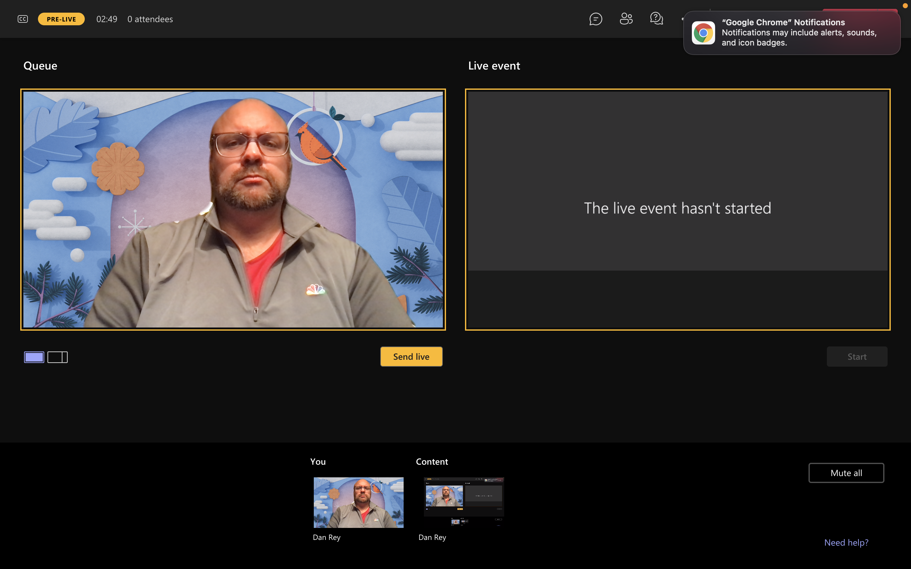
Live Event – Pre-Live (setup your screen share and video!)

Slide 5
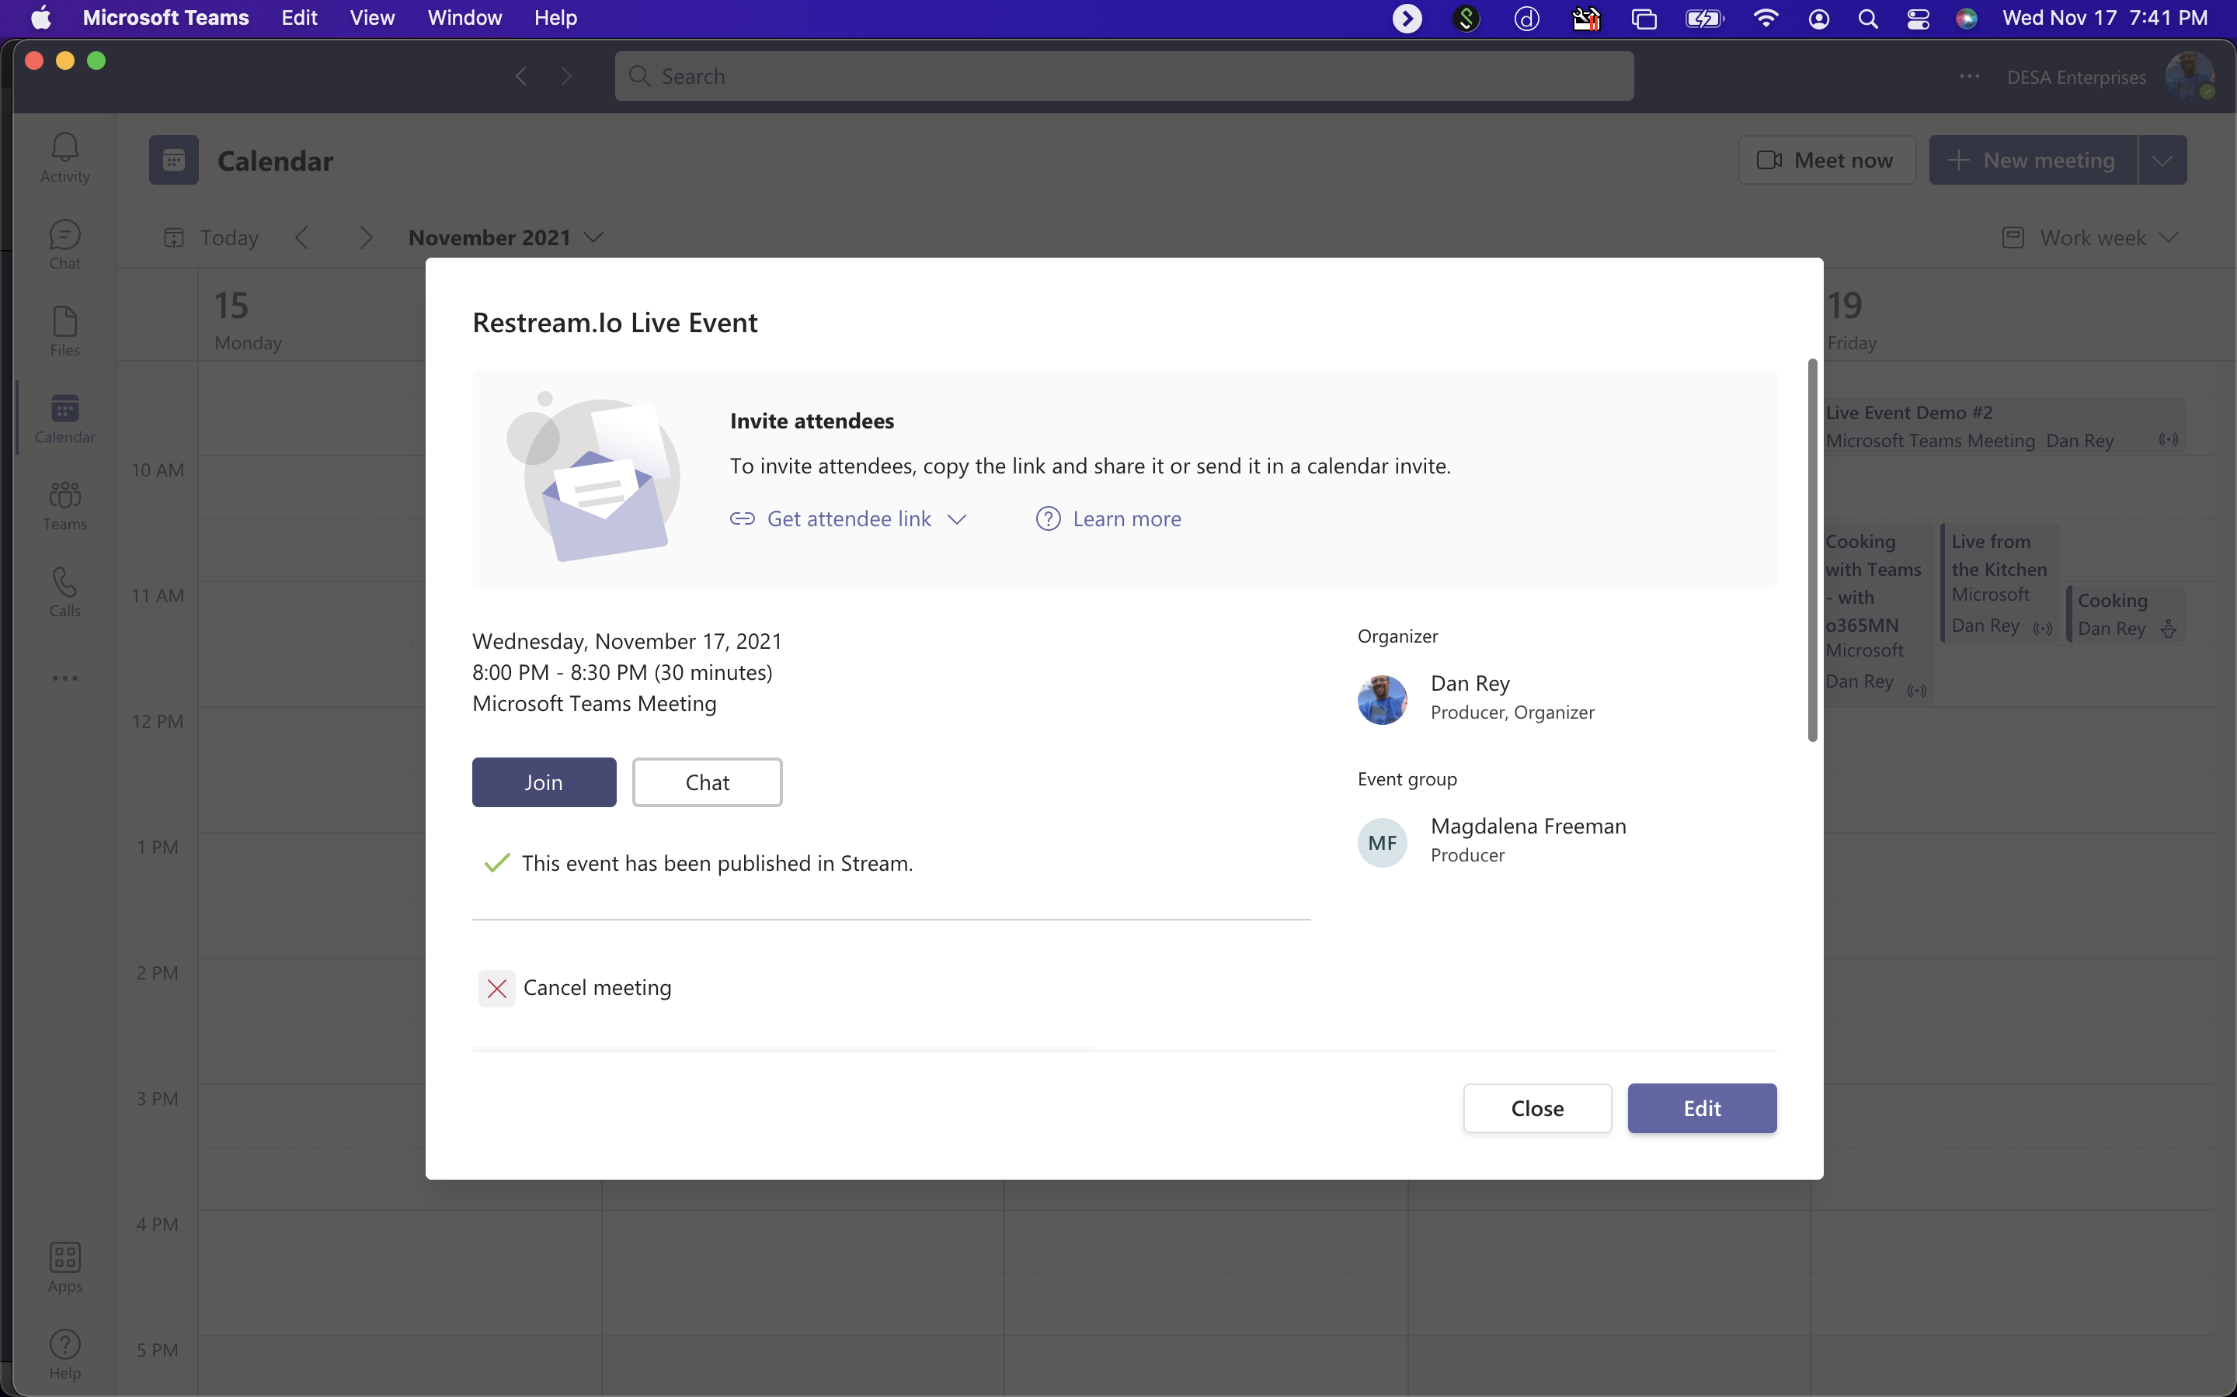
Link to Join As Producer/Presenter (separate Attendee Link)

Slide 6
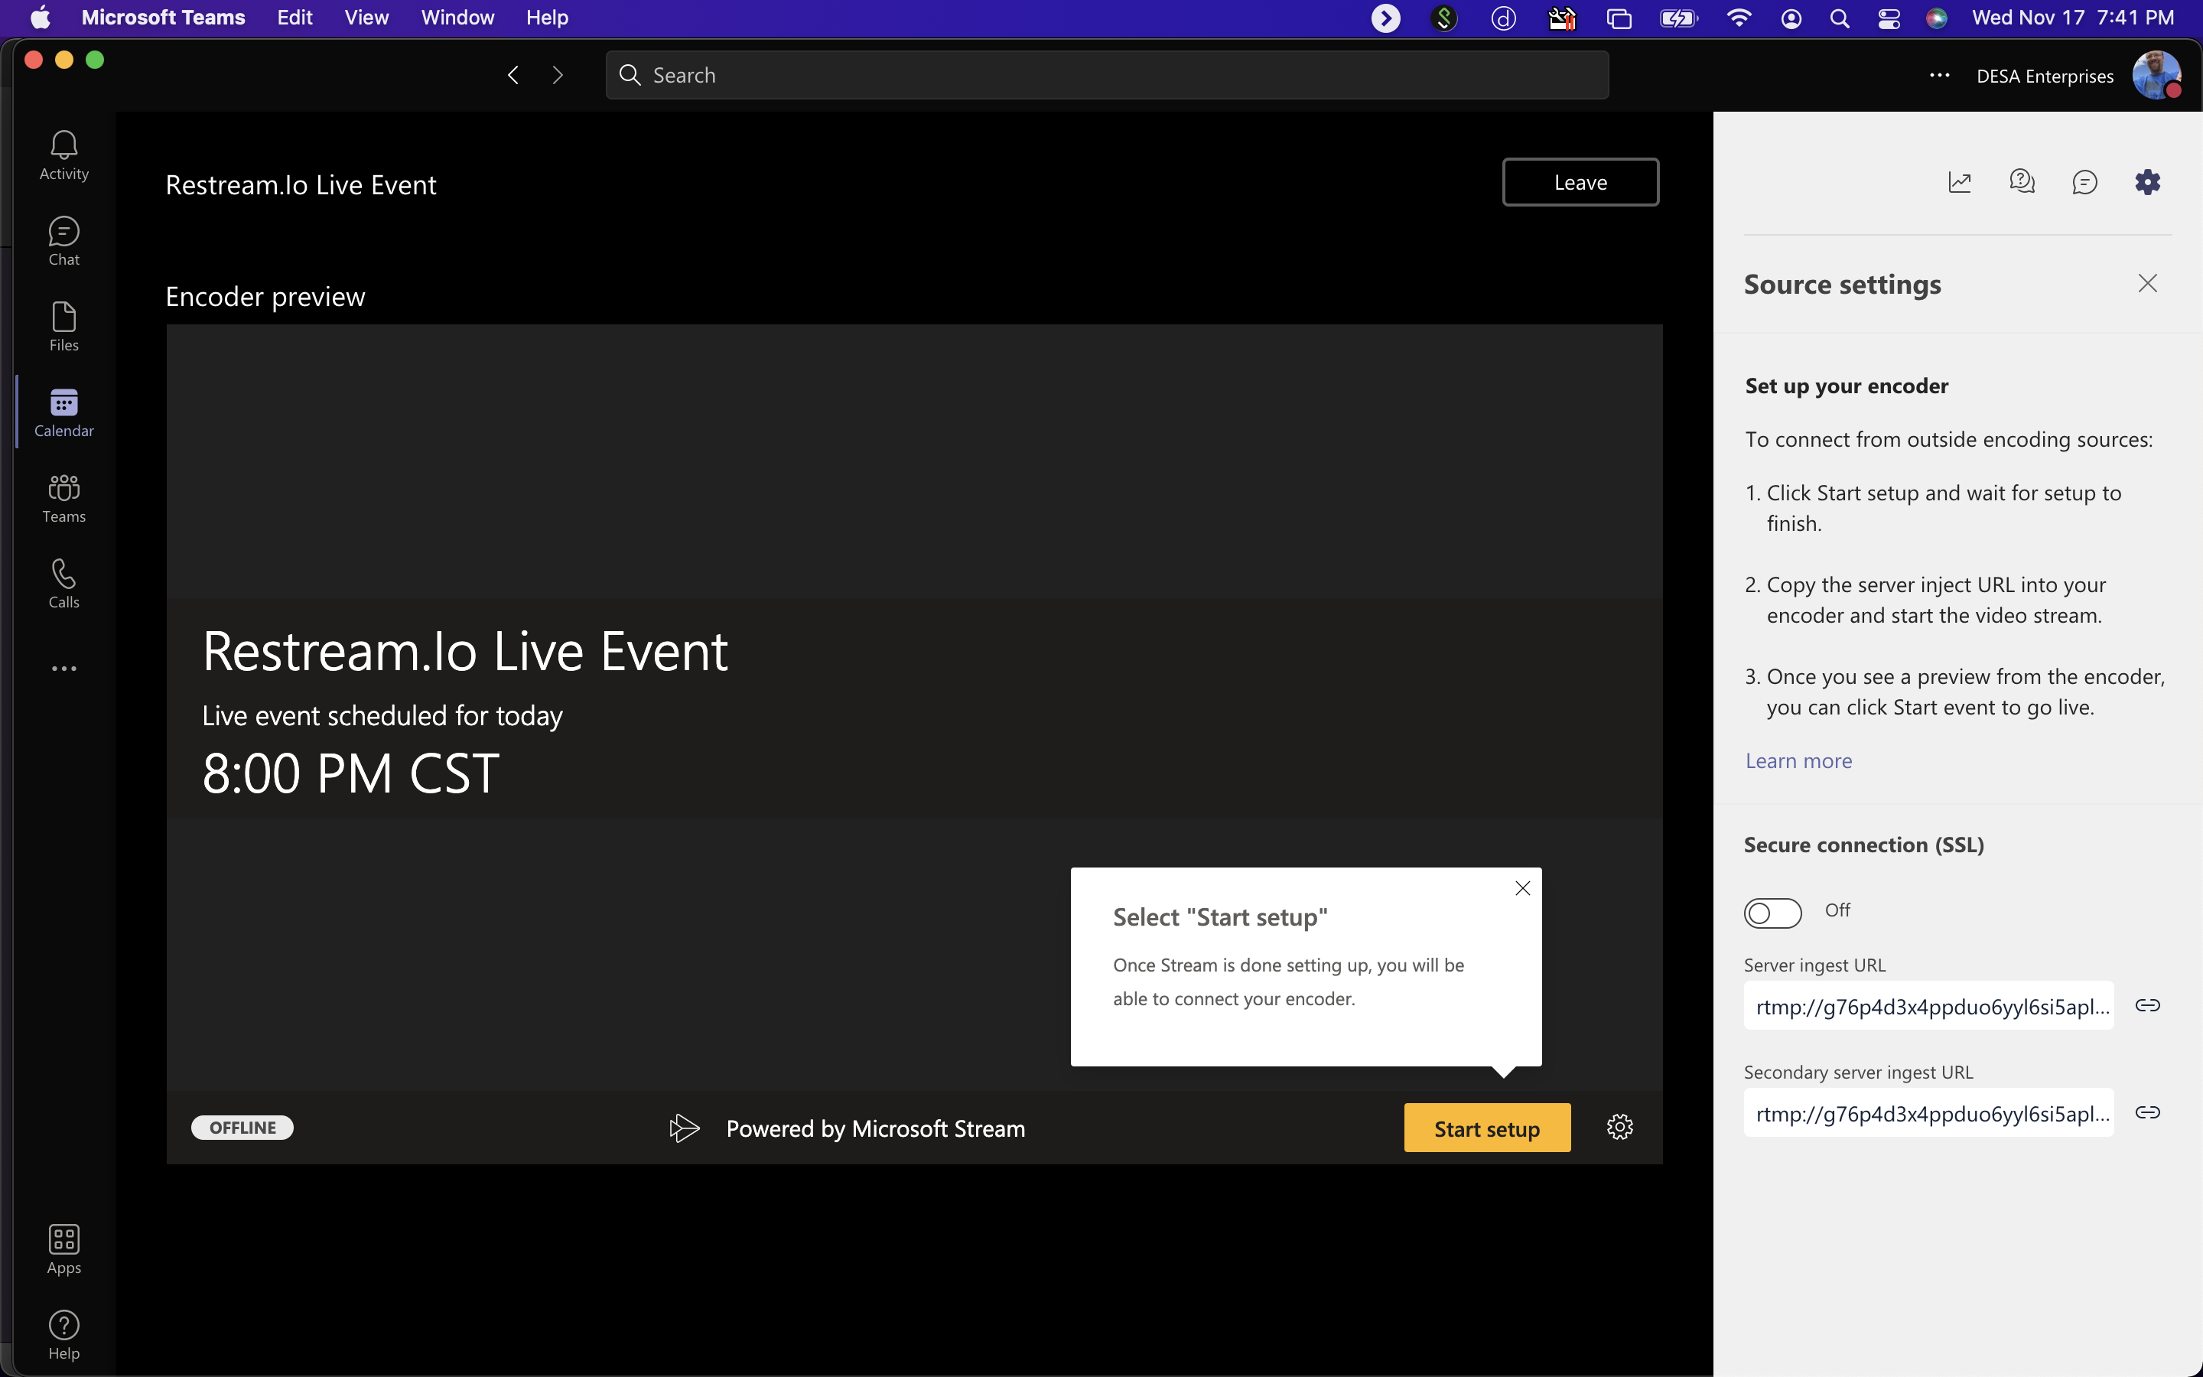
If you are using a separate app to Produce your Live Event…

Slide 7
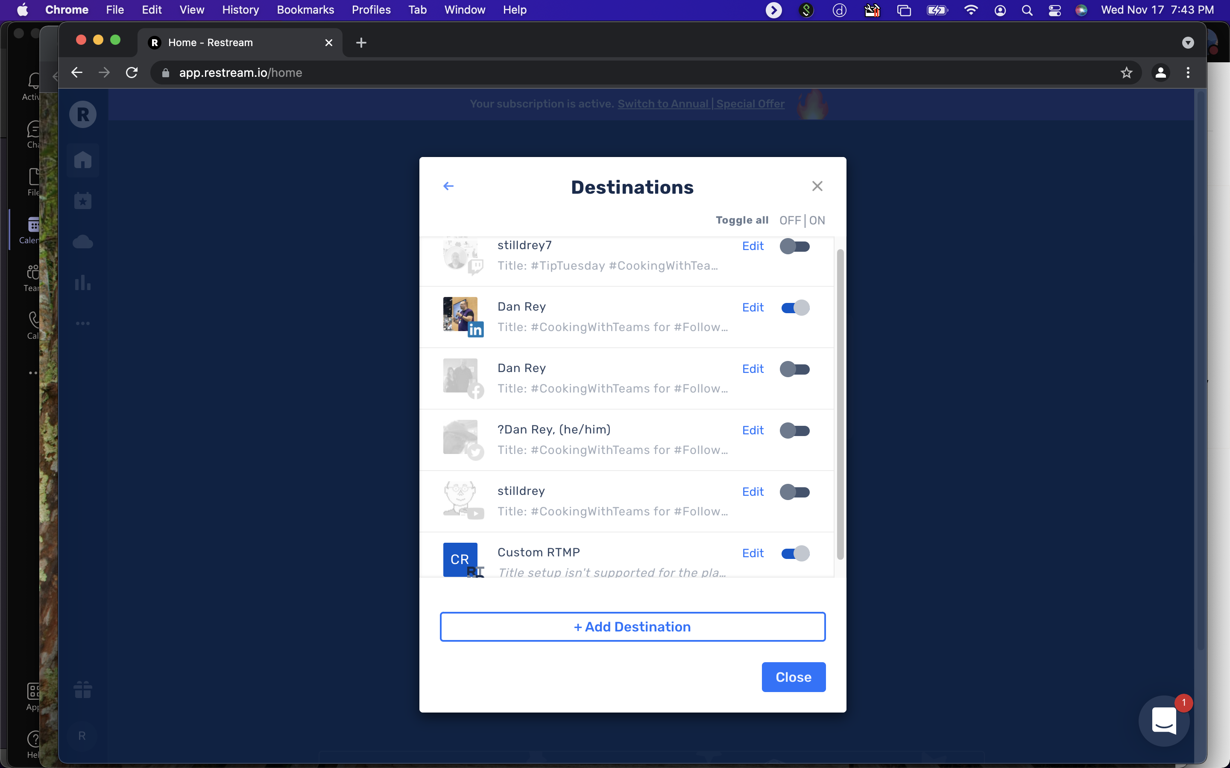
Restream.io settings

Slide 8
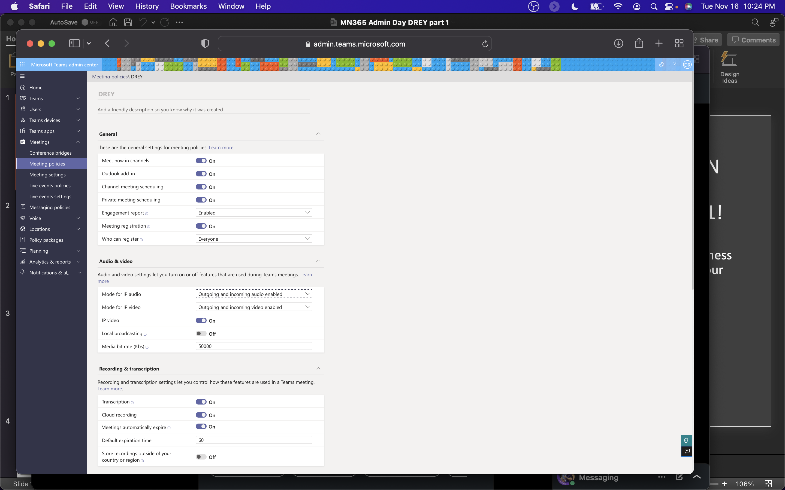
M365 Fall ADMIN Workshop Day 2021!

Slide 9
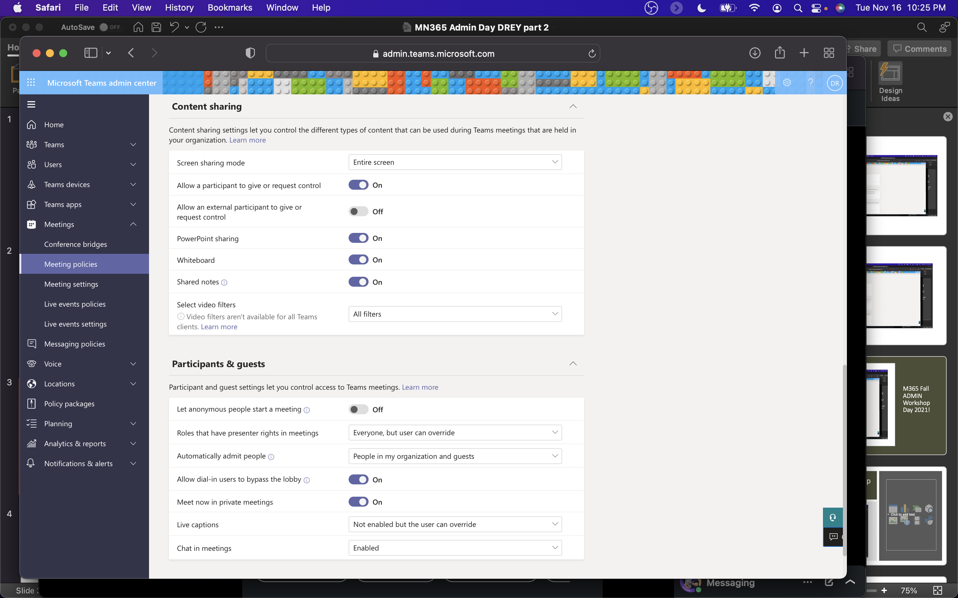
Meeting Policies (cont.)

Slide 10
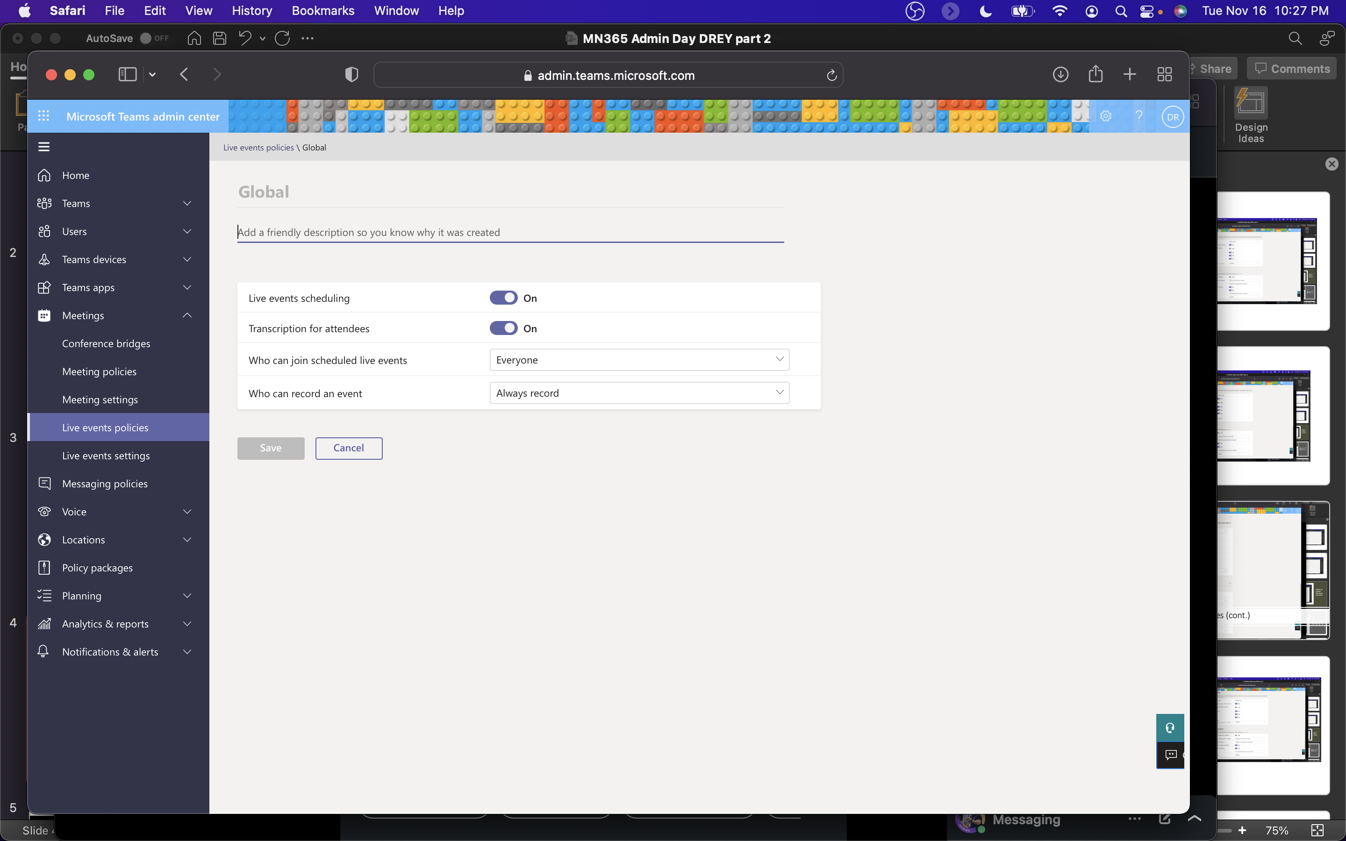
Live Events Policies

Slide 11

Live Event Settings

Slide 12
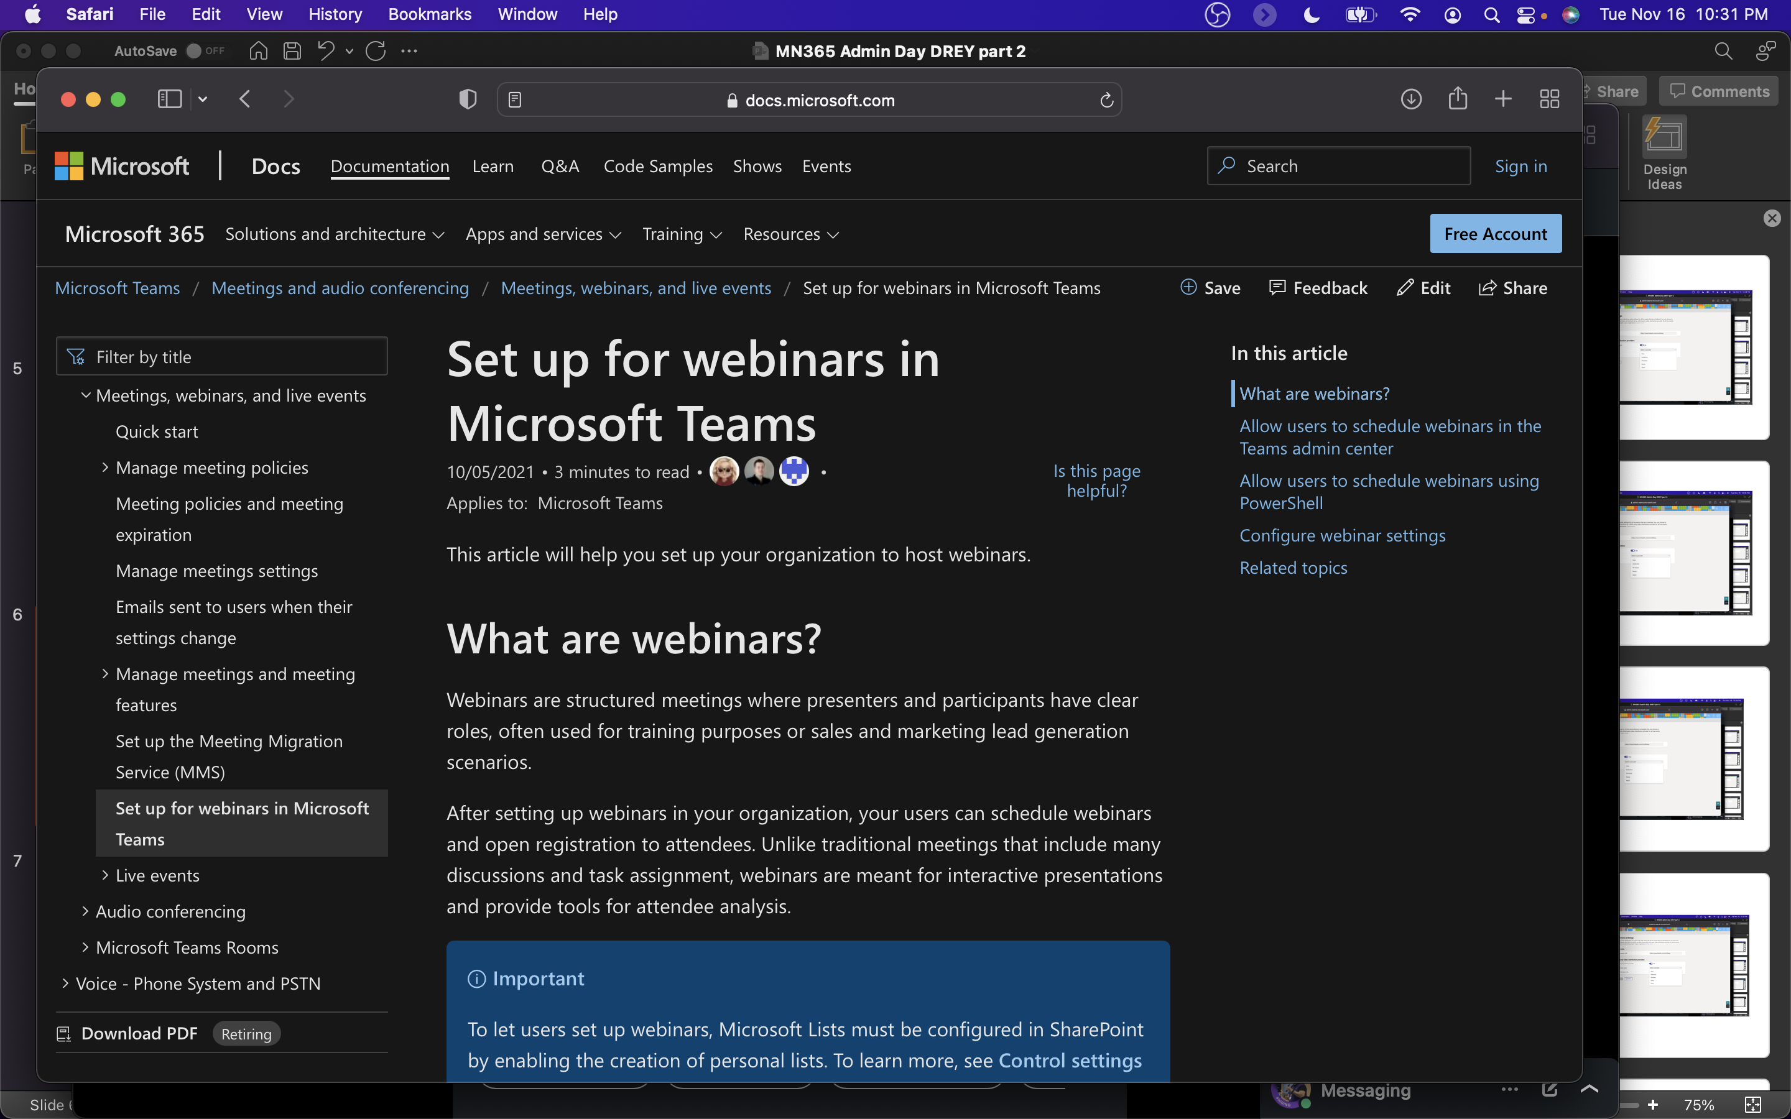
Webinar Admin Settings
https://docs.microsoft.com/en-us/microsoftteams/set-up-webinars

Slide 13
How do you train and demo Live Events in MS Teams?
One great tool is the Windows Sandbox
You can setup the Windows Sandbox with local permissions
The sandbox resets every time you restart it (so it’s like new each version
You can use other virtualization technologies, but then you have to have an operating system

Slide 14
How do you train and demo Live Events in MS Teams (continued)
Other great tools include Hyper-V, Parallels, VMWare Workstation, Oracle VM VirtualBox, etc.
This allows you to have multiple versions of the Teams app running (either as different personas/people or just have multiple meetings open)
You also have multiple browsers and this can assist with different credentials!
Microsoft Edge, Chrome and Microsoft Edge Insiders builds (Dev, Beta and Canary) give you at least FIVE separate browsers to login from as different accounts to Microsoft Teams!

Slide 15
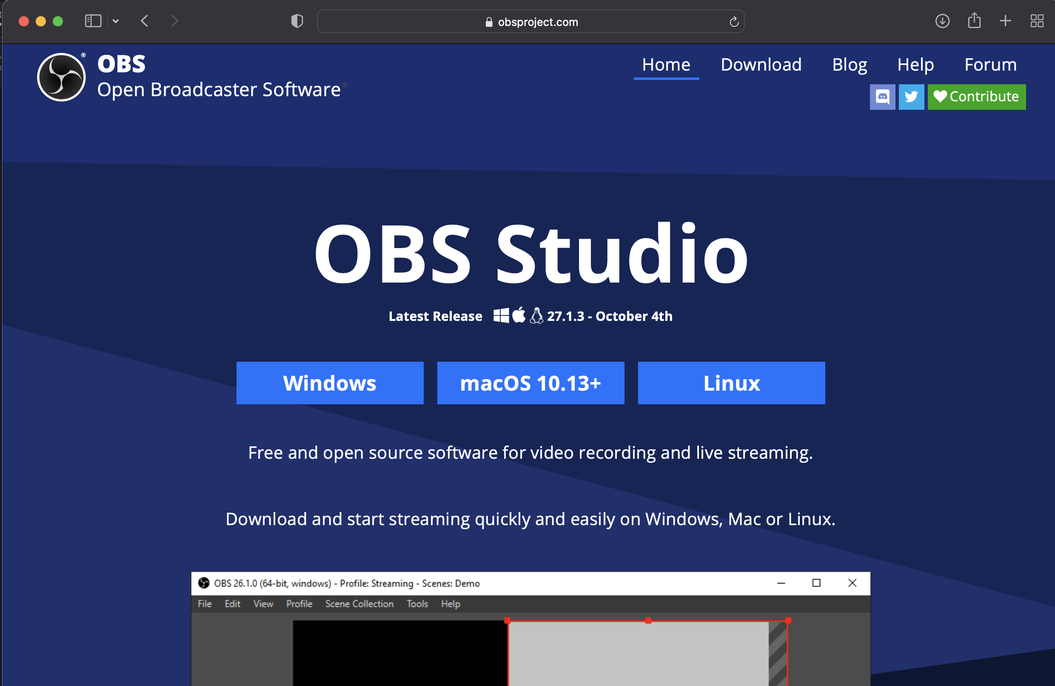
OBS (Open Broadcaster Software) http://obsproject.com

Slide 16
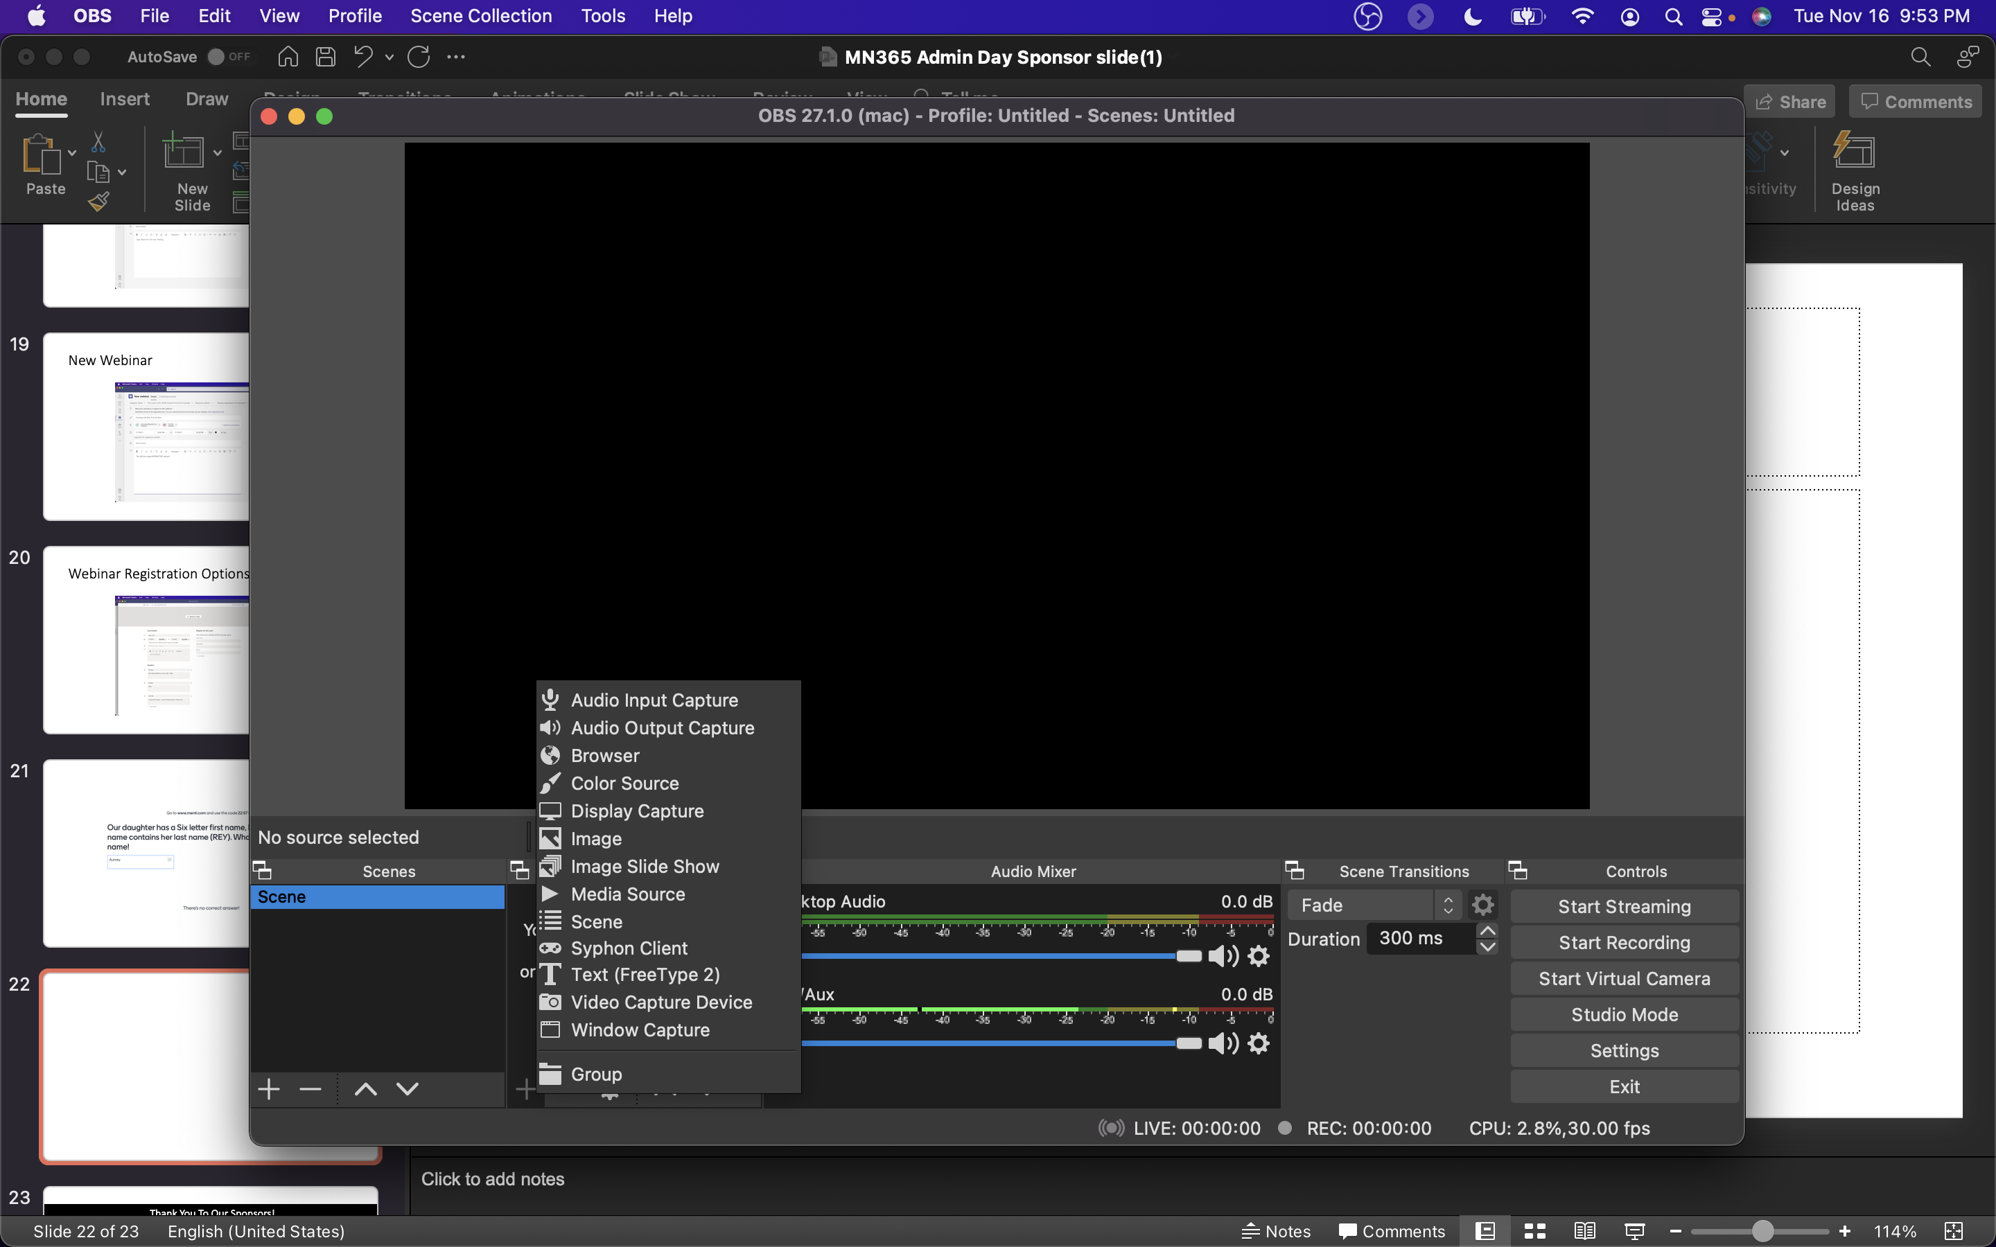
OBS (Open Broadcaster Software)

Slide 17
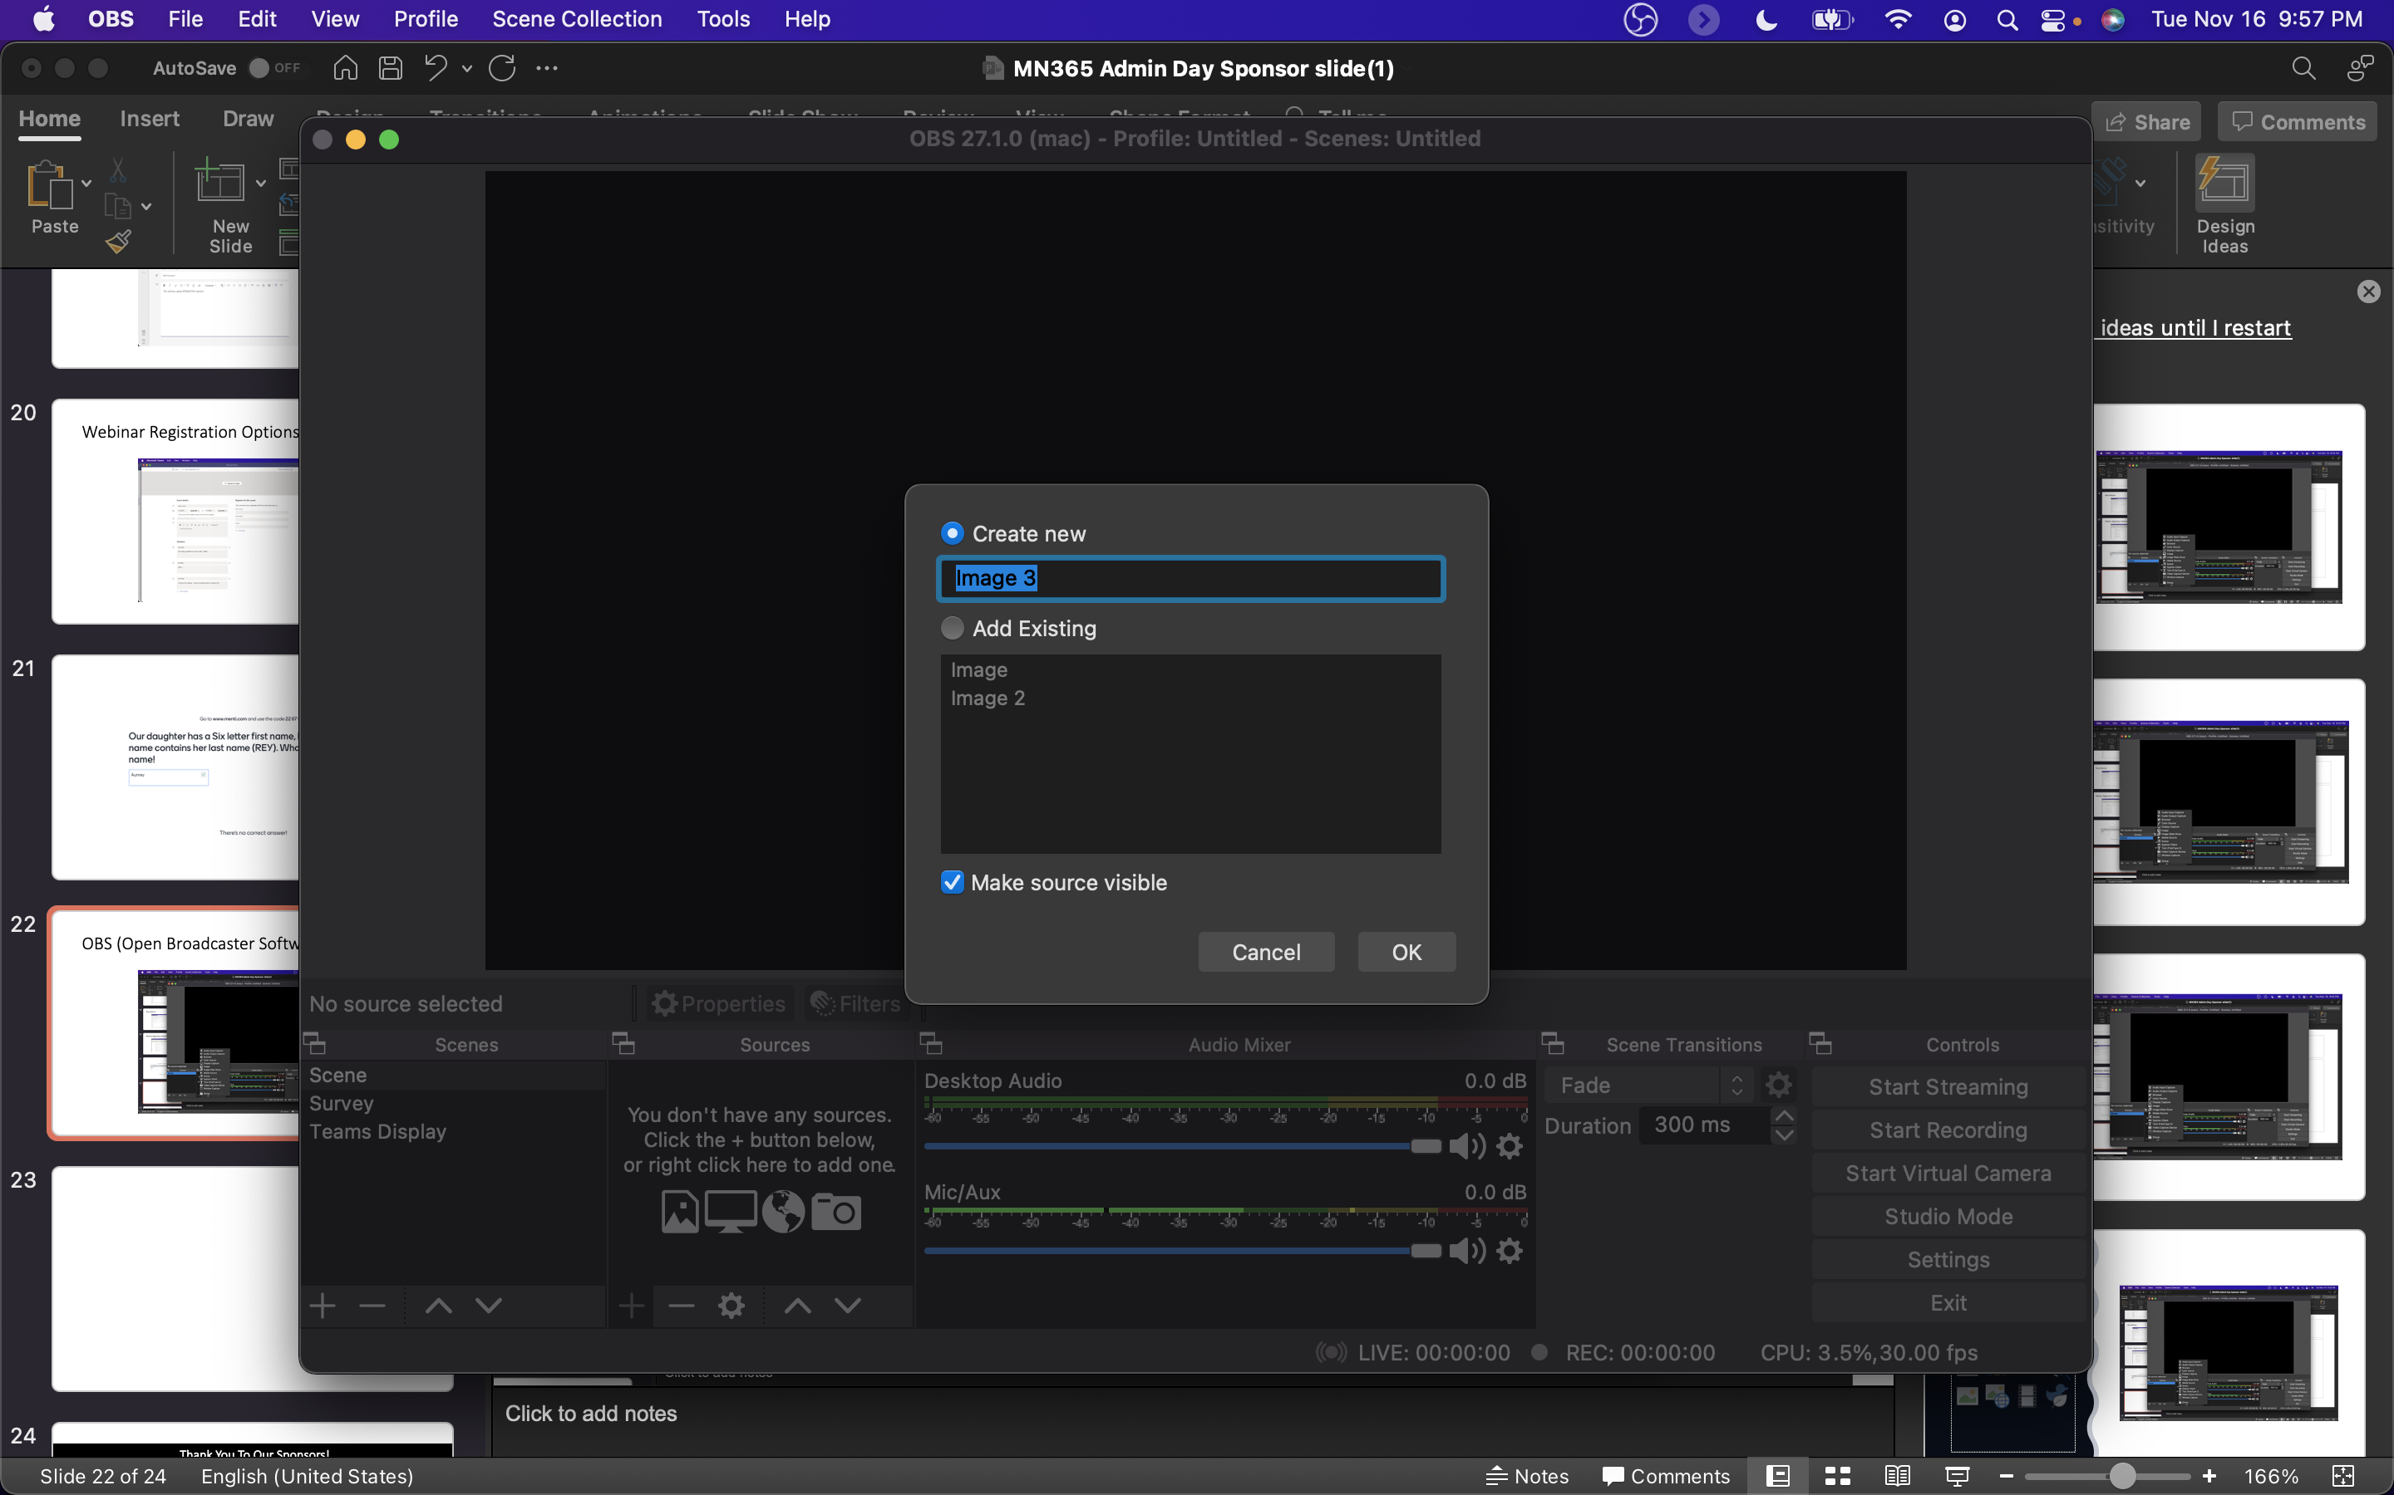
Sources can be images, video, screen sharing, etc.

Slide 18
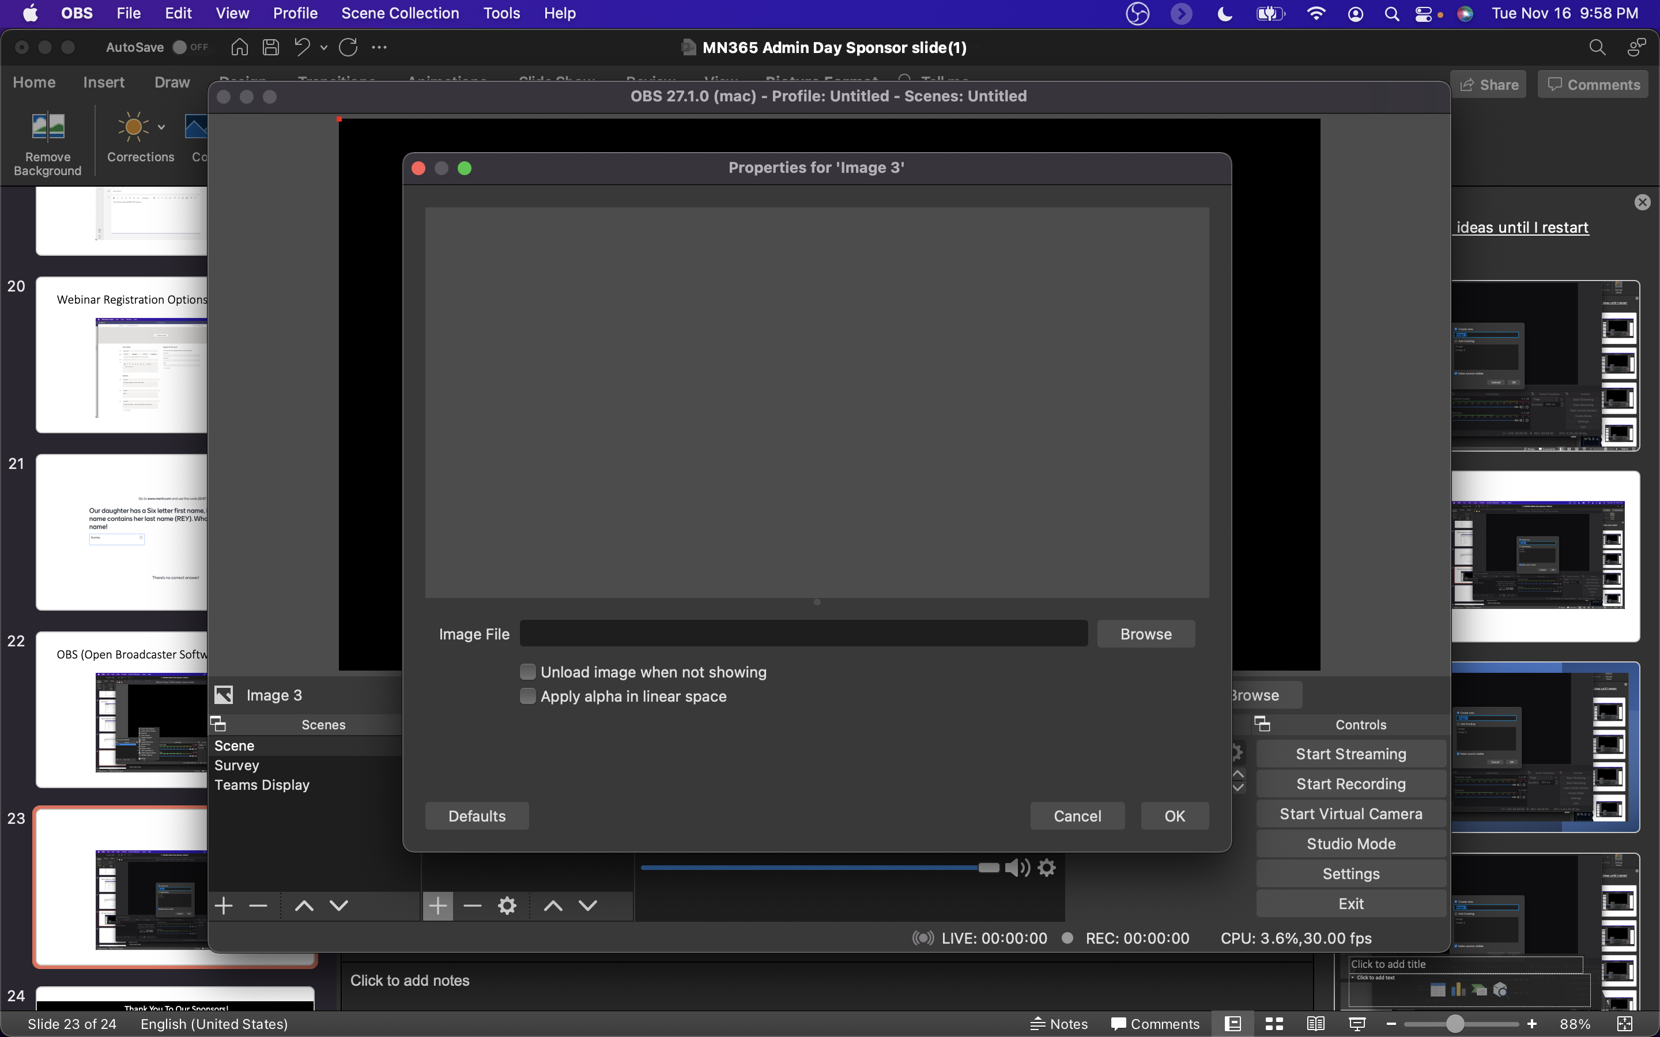
For images or pre recorded video, choose the file

Slide 19
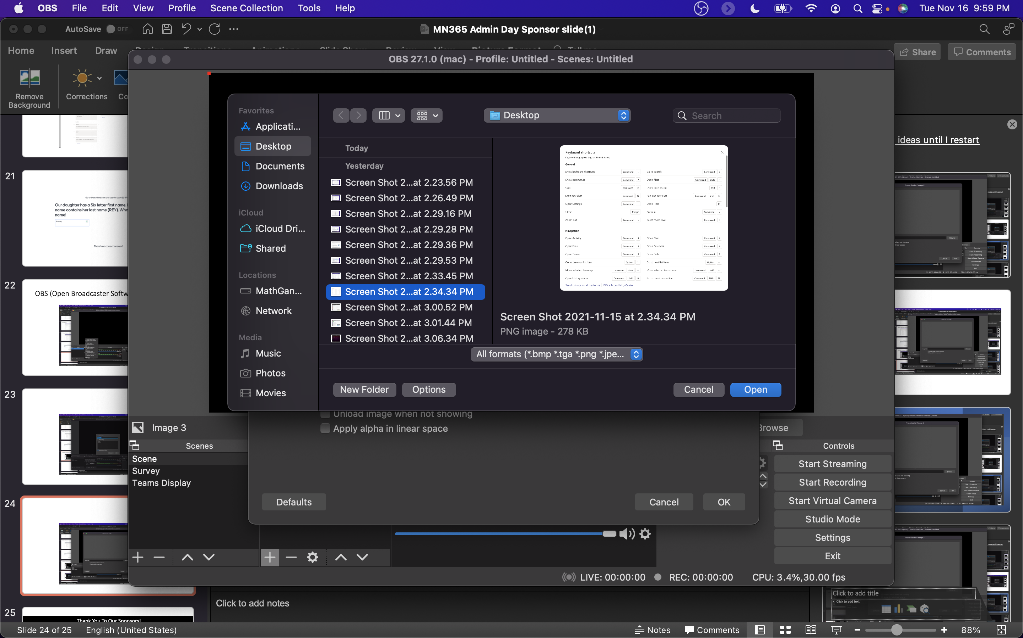
Demo: Microsoft Teams Keyboard Shortcuts

Slide 20
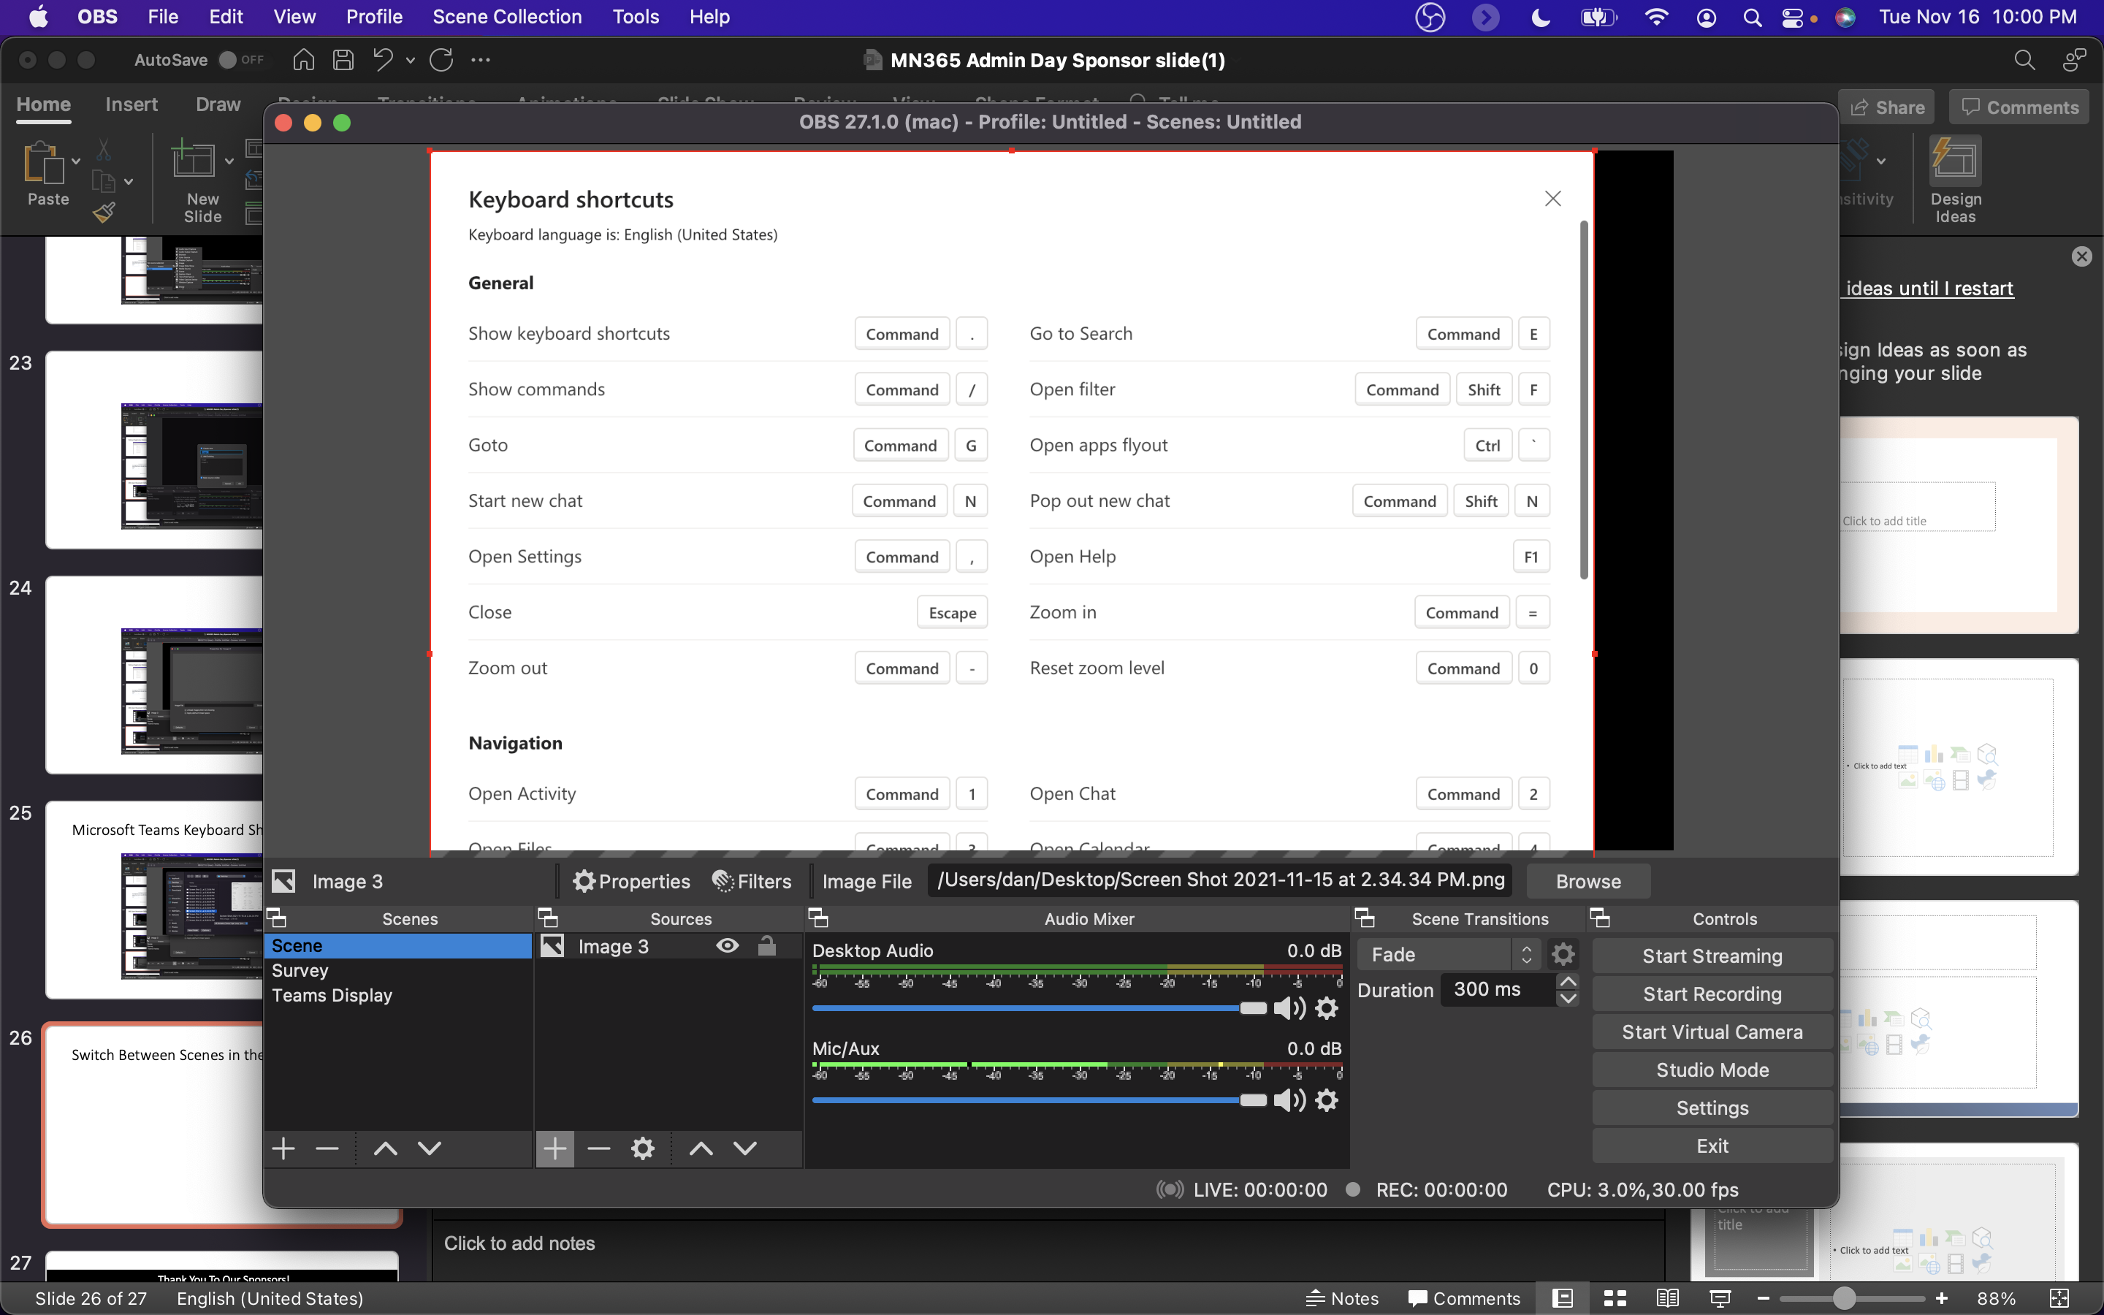
Switch Between Scenes in the lower left

Slide 21
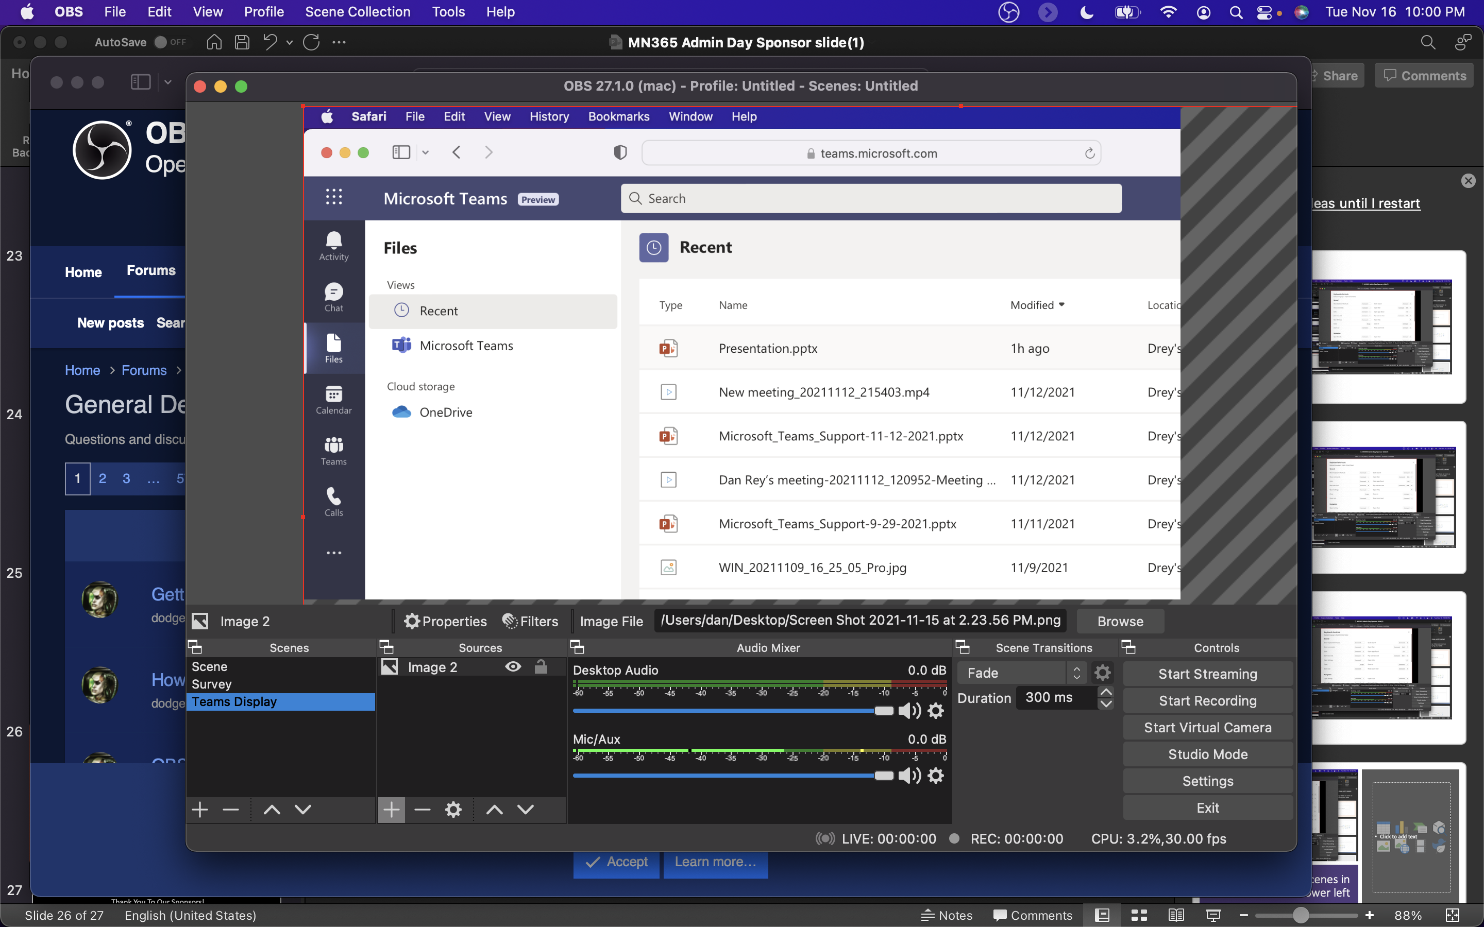
Composite (image, video, live camera, overlay layers, etc.)

Slide 22
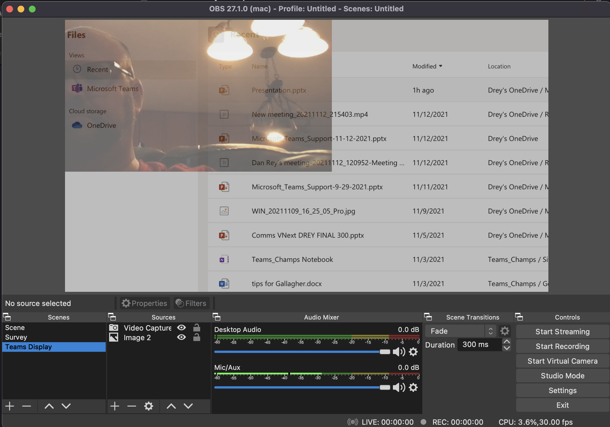
OBS Video + Image and Opacity to see both on top of each other (could also put next to each other)

Slide 23
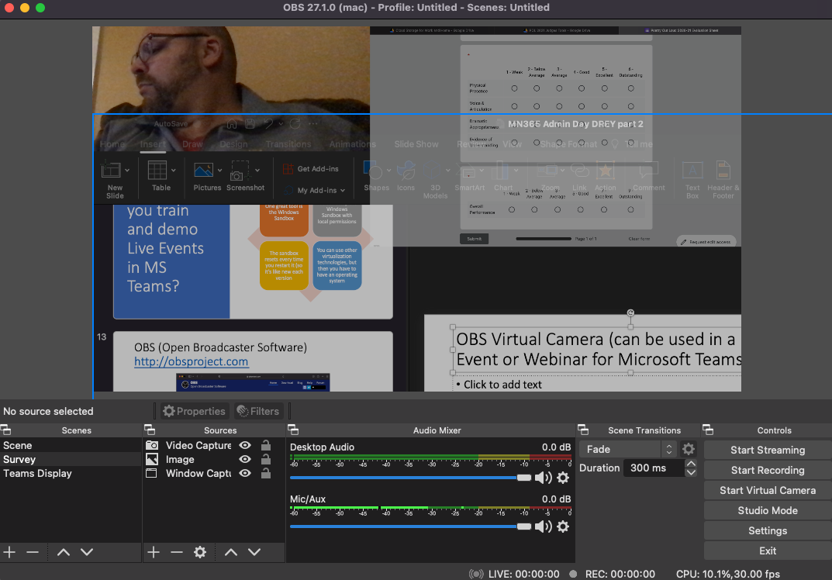
OBS Virtual Camera (can be used in a Live Event or Webinar for Microsoft Teams!)

Slide 24
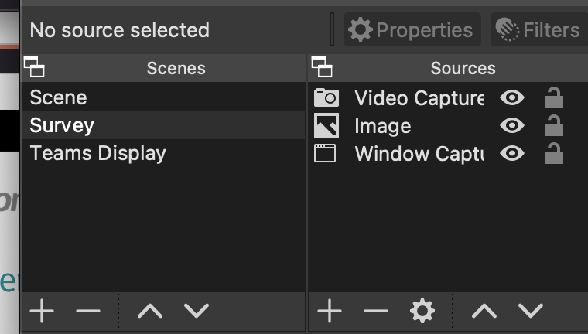
OBS – Sources (video, window, images, screen or app share, etc.) and Scenes to switch between layers (video overlayed on Whiteboard, PowerPoint with a video window, two shared apps, etc.)

Slide 25
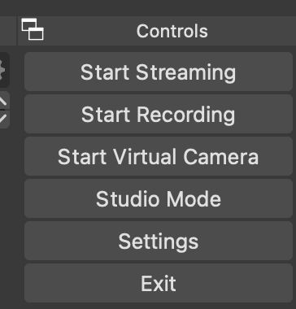
Lower right – turn on the virtual camera

Slide 26
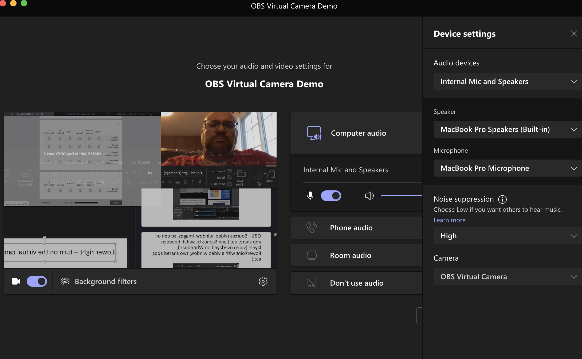
Meanwhile in Microsoft Teams… (lower right OBS Virtual Camera!)

Slide 27
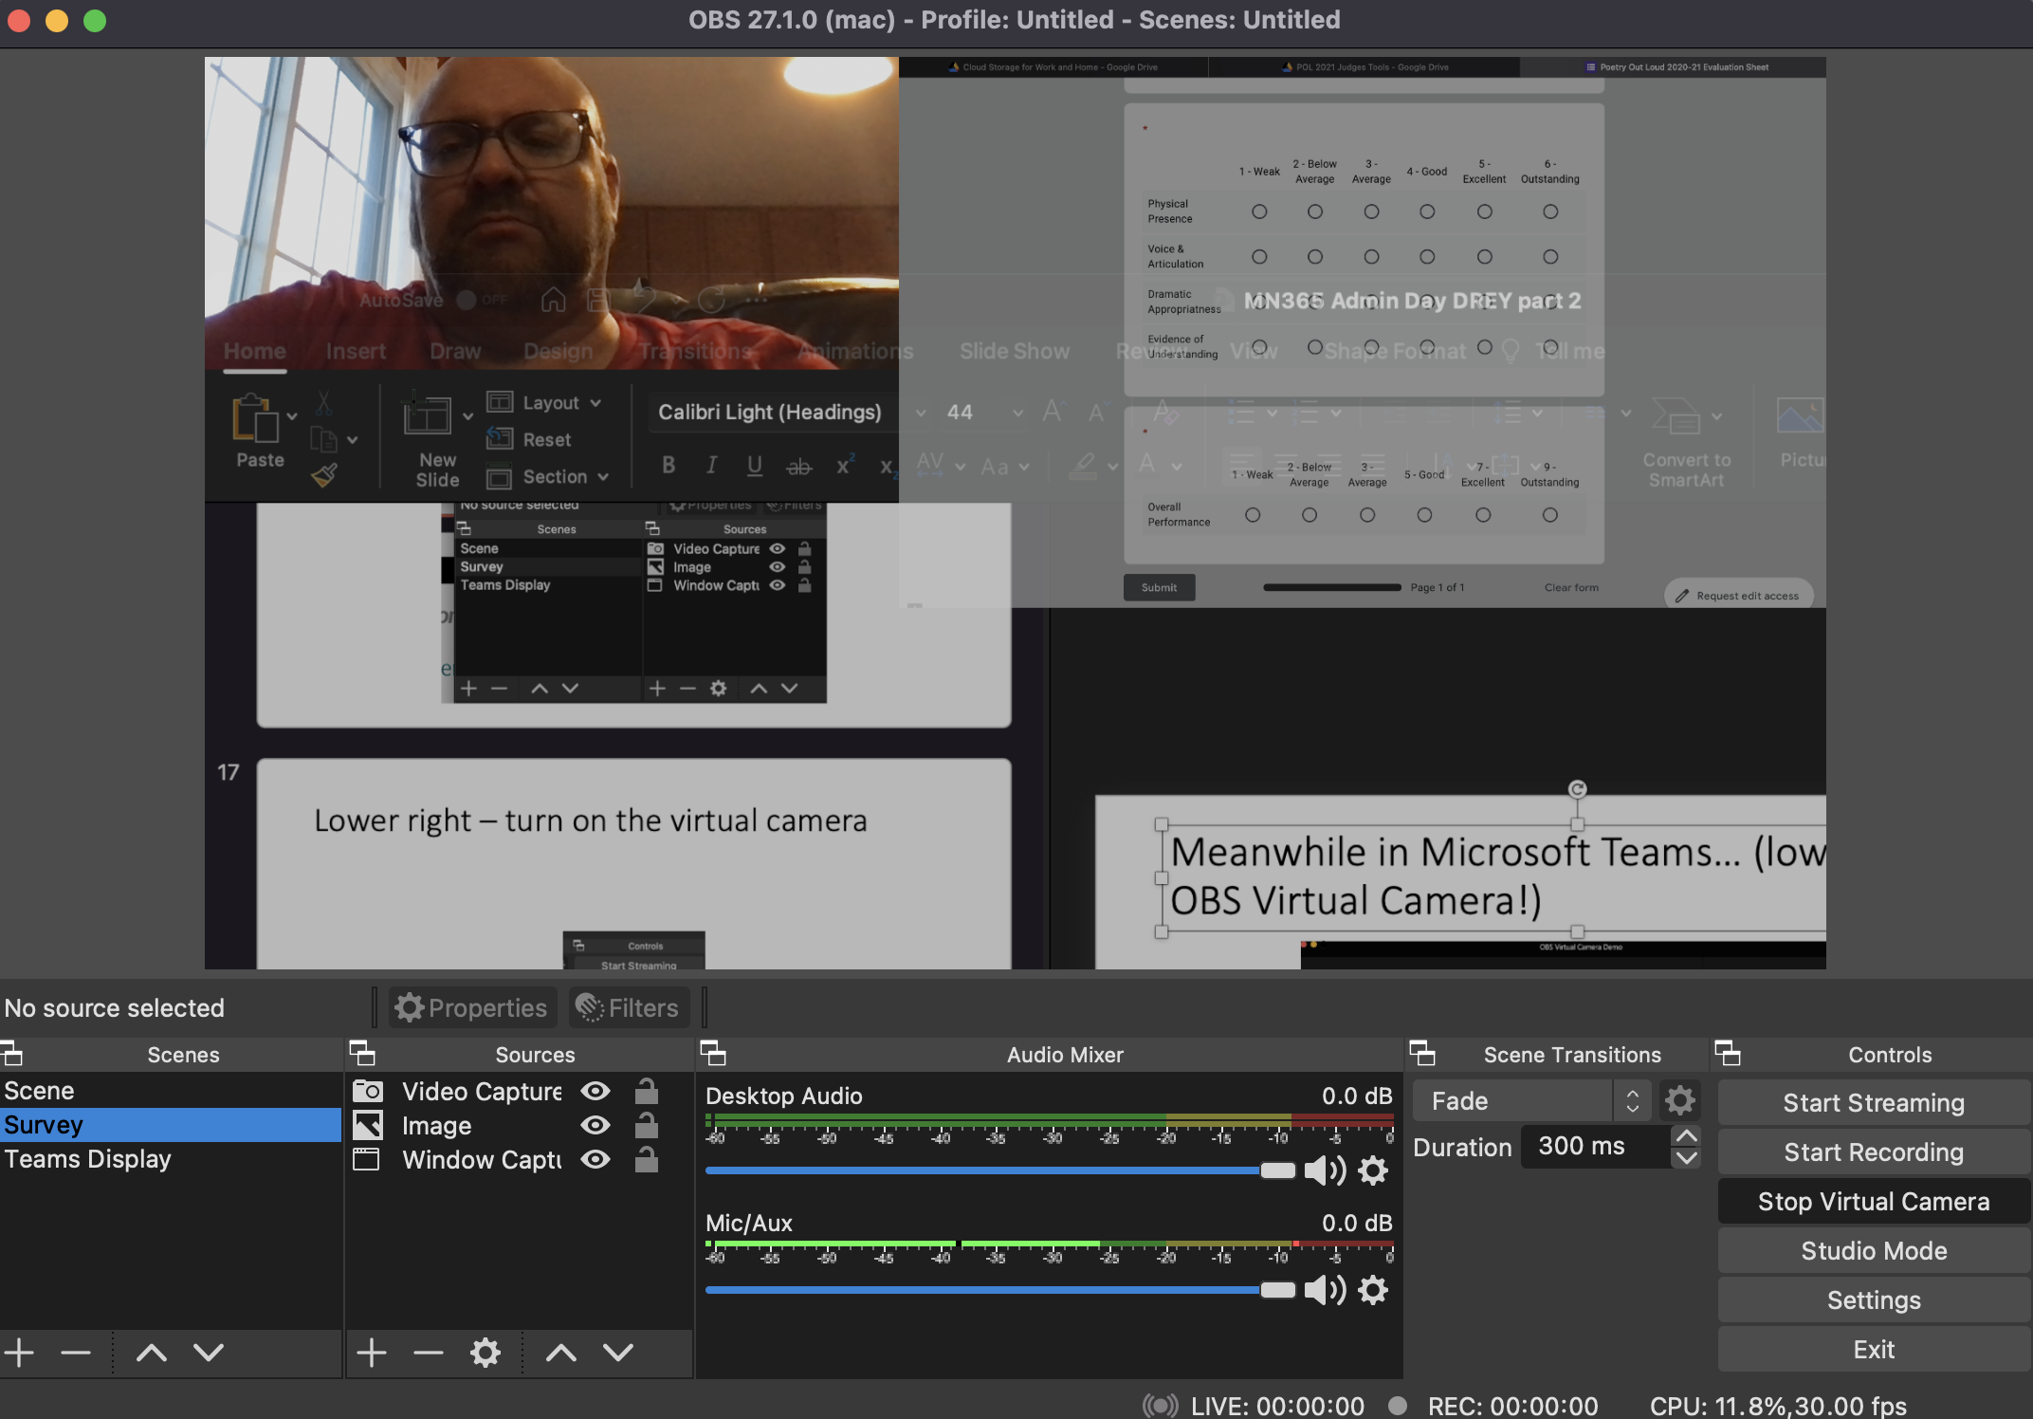
Switch Your Scene in OBS and it take effect in Microsoft Teams!

Slide 28
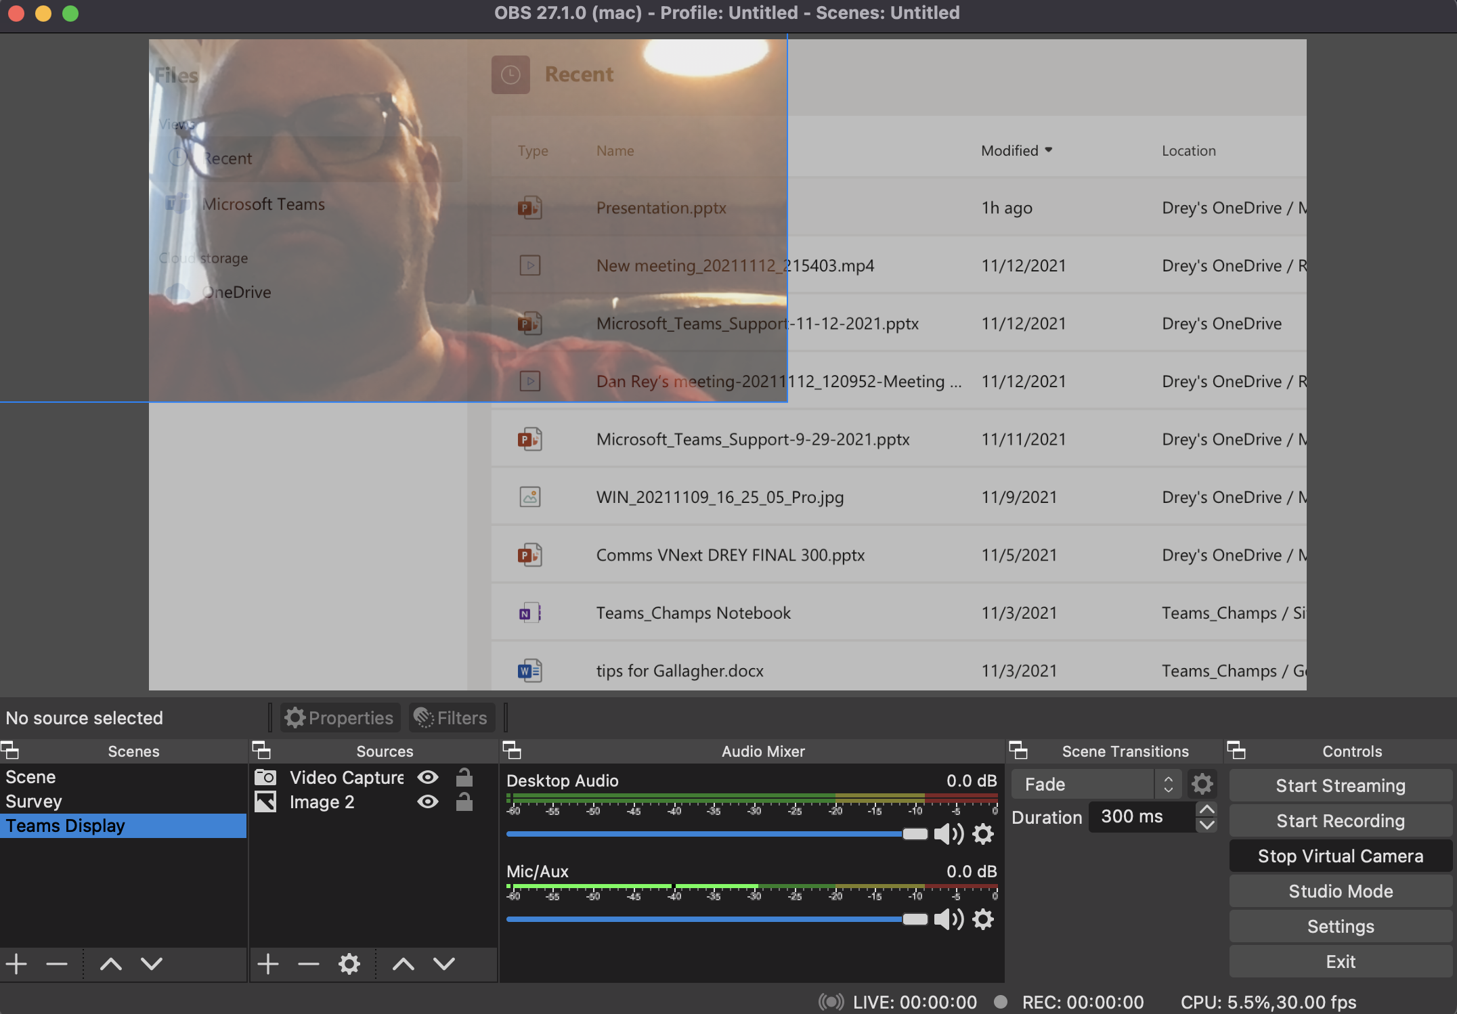
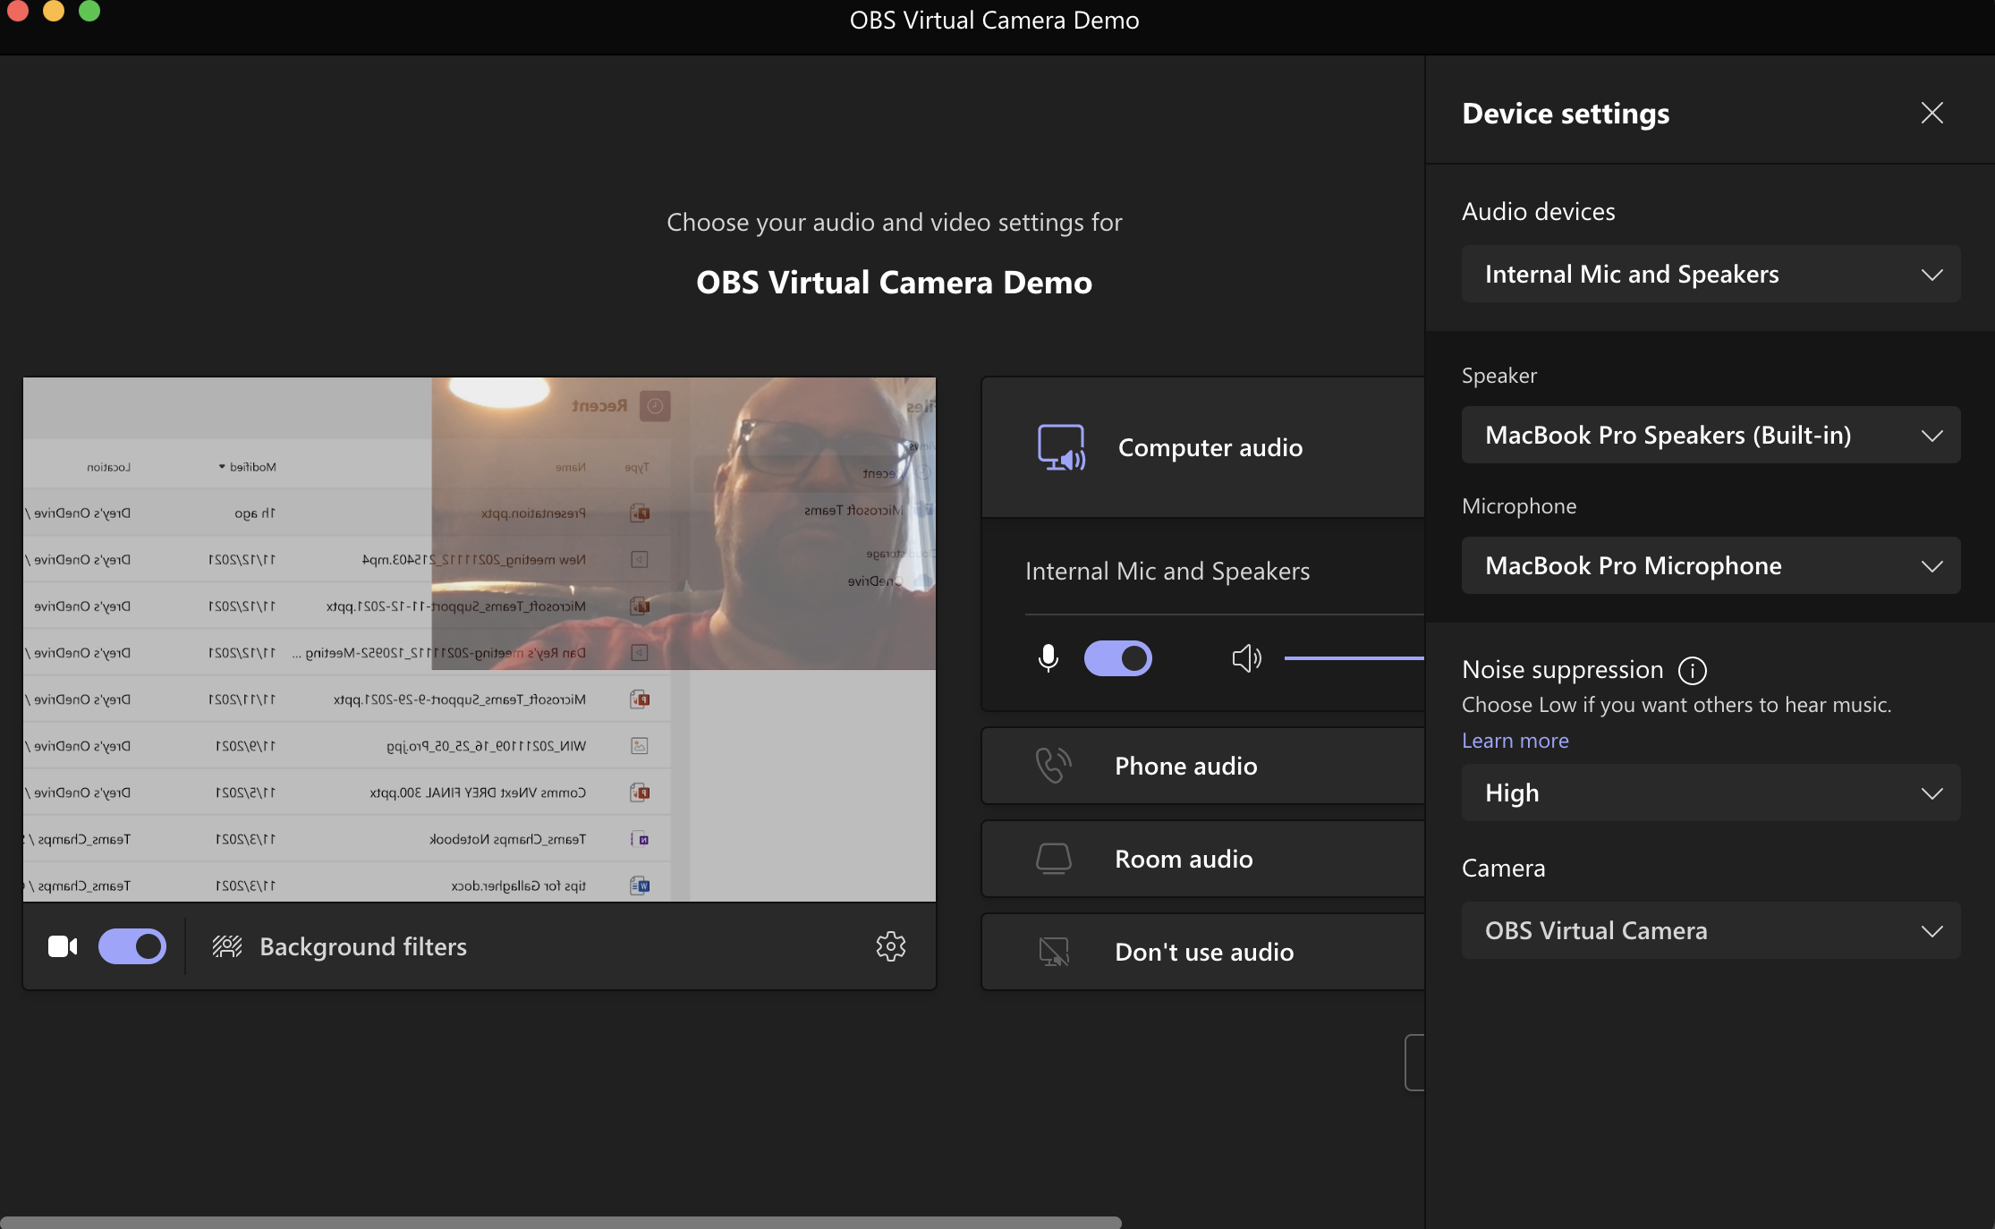
On the Left – OBS On the Right – MS Teams!

Slide 29

Thank You To Our Sponsors!

